Slide 1


Netflix Stock Price Prediction and Trend Analysis Using LSTM and Prophet
Course & Module: MSc in AI, Programming for AI
By:
Kshitij Nakhwa (23267402)
Illiyaz Ahmed Khan (23287594) Shravani Waghmare (23305665)
Hitesh Patil (23145331)

Slide 2

Introduction to Stock Price Prediction
Overview of Stock Price Prediction:
Stock price prediction aims to estimate future prices based on historical data. It is a critical area in finance, enabling better investment strategies and risk management.Example: Predicting various stock trends can guide investors on buying/selling decisions.
Objective: To build a predictive model using various Machine Learning Models to forecast various stock prices based on historical data.

Slide 3


Literature Review
Summary of Existing Work:Research shows diverse methods for stock price prediction, ranging from statistical models like ARIMA to machine learning models like SVMs and deep learning techniques like LSTM.Linear regression is a baseline method often used to establish a foundational understanding of the relationship between variables
Which various Machine Learning Models?.
Random Forest Regressor and LSTM and Prophet. Simplicity and ease of implementation.Provides a clear understanding of how independent variables (e.g., time, historical prices) influence the dependent variable (future stock price).Suitable for initial exploration before moving to complex models.

Slide 4


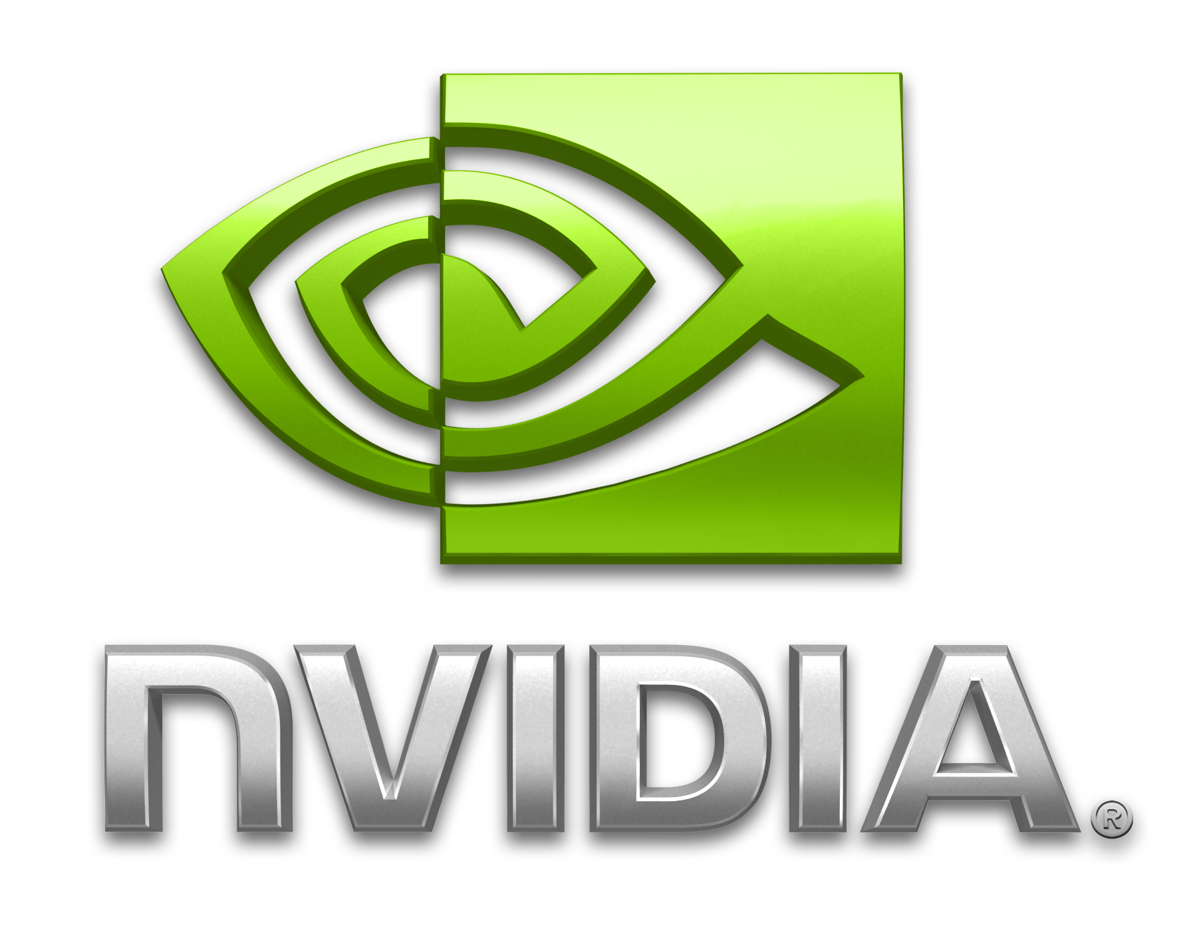



Dataset Overview
Source: Various stock data sources from stock's datasets like Netflix, Amazon, SONY, Nvidia.
Link: Netflix Stock Data and Key Affiliated Companies
Key Variables:
Date: The trading day.
Open: Price at market open
Close: Price at market close.
AdjClose: Price at market is adjacently close.
High: Price at market is high.
Low: Price at market is low.
Volume: Total shares traded.
Number of Records:The dataset contains approximately more than 5,000 records spanning over several years.

Slide 5



Tools and Technologies
Programming Language:Python was chosen for its robust data manipulation and machine-learning libraries.
Libraries Used:
pandas: Data manipulation and analysis.
NumPy: Numerical computations.
Matplotlib and mplfinance: Data visualization(candle stick graph).
scikit-learn: Machine learning (a Machine Learning Model).
Tensorflow: LSTM model
And various other ML models.
Environment:
Jupyter Notebook was used for its interactivity and visualization capabilities.

Slide 6


Methodology
Data Preprocessing:
Identified and handled missing values by using interpolation. Normalized data for consistent scaling.
Splitting Data:
Divided into 80% training and 20% testing subsets to evaluate the model.
Exploratory Data Analysis (EDA):
Visualized stock trends over time using line plots, Scatterplot, Pairplot and Candlestick graph .
Analyzed correlation between variables to identify relationships.
Machine Learning Models Implementation:
Defined the independent variable (time) and dependent variable (stock price).
Trained the model using the training dataset. Predicted stock prices on the testing dataset using various ML models.

Slide 7



Machine Learning Models Used:
RFrff
Random Forest Regressor
LSTM
Prophet

Slide 8


Results
Evaluation Metrics:
RMSE (Root Mean Squared Error): Measures prediction accuracy by quantifying the difference between predicted and actual values.
R-squared: Indicates the proportion of variance explained by the model.
Visual Comparison:Graphs show predicted vs. actual stock prices, highlighting the model's performance.

Slide 9

Key Findings:
Mean Squared Error for RandomForestClassifier Model: 0.01761911246102543
Mean Squared Error for LSTM Model: 0.002142414698274324
Limitations in computational costs and overfitting for Random Forest Regressor and complexity increase for LSTM model.

Slide 10

Challenges Faced
Noisy data from stock market fluctuations.
Model Limitations:
Interpretability of Prophet
Limitations in computational costs and overfitting for Random Forest Regressor
Complexity increase in LSTM model.
Unable to account for external factors like news, economic policies, or market sentiment.

Slide 11

Conclusion
Summary of Findings
This Machine Learning Models provides a good baseline for stock price prediction.
The model successfully predicted trends but lacked precision in volatile scenarios
Limitations:
Restricted to stock Analysis.
Impacted by noise and external market factors.
Future Work:
Usage of advanced features like Market Sentiment Analysis for prediction.
Incorporate additional features like macroeconomic indicators and market sentiment analysis.

Slide 12

Future Trends in Stock Prediction
The future of stock price prediction may involve integrating machine learning and AI with various Machine Learning Models.
These technologies can enhance predictive accuracy and uncover complex relationships in data, leading to better investment strategies and market insights.

Slide 13
Mentor: Prof. Shreyas Arun Setlur.
References:
1. S. Vohra and P. Savaridassan., "Stock Price Trend Analysis and Prediction of Closing Price Using LSTM," 2023 International Conference on Computer Communication and Informatics (ICCCI), Coimbatore, India, 2023, pp. 1-5, doi: 10.1109/ICCCI56745.2023.10128260.
2. S. Sarode, H. G. Tolani, P. Kak and C. S. Lifna, "Stock Price Prediction Using Machine Learning Techniques," 2019 International Conference on Intelligent Sustainable Systems (ICISS), Palladam, India, 2019, pp. 177-181, doi: 10.1109/ISS1.2019.8907958.

Slide 14
References:
3. S. Kumar, N. Pal and A. M. Tripathi, "Improving Long Short-Term Memory (LSTM)-Based Stock Market Price Predictions in the Machine Learning Era," 2024 IEEE International Conference on Computing, Power and Communication Technologies (IC2PCT), Greater Noida, India, 2024, pp. 923-928, doi: 10.1109/IC2PCT60090.2024.10486391.
4. S. Sarode, H. G. Tolani, P. Kak and C. S. Lifna, "Stock Price Prediction Using Machine Learning Techniques," 2019 International Conference on Intelligent Sustainable Systems (ICISS), Palladam, India, 2019, pp. 177-181, doi: 10.1109/ISS1.2019.8907958.

Slide 15
References:
5. V. Sarika, G. V. S. Kamal, S. V. Pratham, N. V. S. S. Deepak and T. Veneela, "An LSTM-Based Model for Stock Price Prediction," 2023 Annual International Conference on Emerging Research Areas: International Conference on Intelligent Systems (AICERA/ICIS), Kanjirapally, India, 2023, pp. 1-6, doi: 10.1109/AICERA/ICIS59538.2023.10420270.
6. Khoirudin, P. T. Pungkasanti and N. Wakhidah, "ANTM.JK Stock Price Prediction Using Long Short-Term Memory (LSTM) Method During COVID-19 Pandemic," 2023 International Conference on Technology, Engineering, and Computing Applications (ICTECA), Semarang, Indonesia, 2023, pp. 1-5, doi: 10.1109/ICTECA60133.2023.10490699.

Slide 16
Thanks!

